Slide 1
Who Are We?
Attachment and the Essence of Being
Dr Paul Holmes

Slide 2
Questions of Being
Who are you?
What factors do you consider have influenced the development of your being?
Let’s consider a child’s history

Slide 3
The child’s brief history
As an infant carried to safety from a war zone in a cot made from a fruit box
When a child his mother was placed in an asylum after being diagnosed with schizophrenia
Father goes to live with his mistress
Described at school as a "rugged, boisterous ... but always remarkably polite" boy.

Slide 4
At the age of sixteen his sister, her husband, her two young sons and her mother-in-law were killed in an air crash. He attended the funeral. The following year, his uncle and guardian died of bone cancer.
Goes to live with a relative who has one of Britain’s largest collection of pornography

Slide 5
So what sort of person did this child become? With this history did they end up in the care system?
In prison?
Mad?
A clue

Slide 6
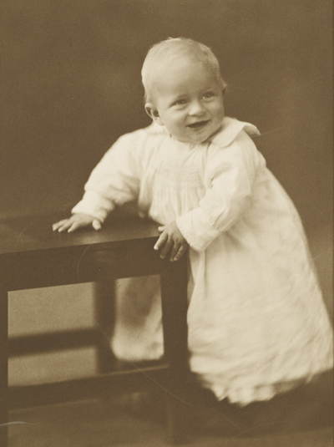
A happy child?

Slide 7
Attachment -the Big Names
John Bowlby
His student:
Mary Ainsworth
Her students:
Patricia Crittenden
Mary Main

Slide 8
A warning
There are significant differences in the categories of attachment of Mary Main
and Patricia Crittenden
Crittenden does not use the category ‘disorganised’ or the diagnosis ‘reactive attachment disorder’
Please do not get confused!

Slide 9
The importance of survival
The basic imperative of any member of a species is to stay alive and safe until it can reproduce and ensure the arrival of the next generation (babies)
Attachment is a biological process that ensures the survival of the infant

Slide 10
Danger (and avoiding it) is the primary organiser of human behaviour
An infant in danger needs to gain proximity to a source of safety and protection– its ‘secure base’
This need applies to many animals including man

Slide 11
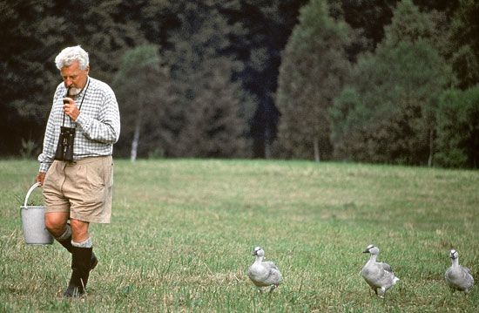
Konrad Lorenz

Slide 12
An infant develops attachment strategies in order to stay safe
These attachment strategies underpin a child’s psychological development from infancy and explain some aspects of the development of the personality
Subsequent life experiences (such as loss and trauma) also impact on attachment styles and personality

Slide 13
Child seeks proximity to its caretaker or ‘secure base’
The attachment strategies used by an infant to achieve this will be strongly influenced by the style of care provided by the parent / carer

Slide 14
Parenting styles
Normative
B Carer reliably available - emotionally attuned, responds to child’s needs
Normative - but less than ‘perfect’ parenting
A Care reliably unavailable – no adequate response to child
C Carer unreliably available – carer sometimes available – sometimes not
Non- normative - neglectful / abusive – inadequate parenting
A Care reliably unavailable – no adequate response to child
C Carer unreliably available – carer sometimes available – sometimes not
D Carer absent (significant neglect), abusive, violent or very unpredictable

Slide 15
B style parenting allows the child to develop a trusting ‘inner working model of the world’ and results in secure attachment styles
A, C & D style parenting inhibits development of a trusting ‘view of the world’ and results in insecure attachment styles

Slide 16
Child’s attachment strategies
Attachment strategies used by infant to gain security from specific figure when:
frightened
tired
hungry
lost
fear of injury or risk of injury
needing comfort
What strategies can you think of?

Slide 17
Child’s organising processes
Infant needs to regulate it’s level of arousal
Very low arousal sleep
      Restoration of bodily resources
Very high arousal screaming
      Aid to survival and protection from danger
Moderate arousal
      Allows learning and social development

Slide 18
Interaction with another person – a ‘secure base’ allows the child to internalise the processes that assist in managing levels of arousal
This process may be considered to be emotional ‘containment’

Slide 19
Infancy
Arms up to carer
Smiling
Crying
Crawling towards carer
If the carer responds appropriately to these ‘prompts’ the child will develop a normative (and possibly secure) attachment

Slide 20
Secure Attachment
When carer provides a ‘secure base’ infant develops sense trust associated with:
  Better capacity to manage its own arousal levels with an autonomous sense of self and ownership of own inner experiences
  Becoming resilient, self-reliant, socially orientated and empathic to distress, higher self esteem and deeper more stable relationship patterns

Slide 21
Insecure Attachments

Slide 22
Ambivalent / enmeshed attachment
  When the carer is unreliably available the child needs to attract the carer’s attention so uses:
    Outbursts of anger
    Cry and screaming
    Complaining and demanding behaviour
    Controlling and / or coercive
    Coy, ‘seductive’, behaviour

Slide 23
Insecure
Avoidant attachment
  When the carer reliably unavailable the child learns it can do nothing to attract the carer’s attention so:
    Does nothing to ‘push’ carer further away
    Inhibits own outbursts of anger
    Learns to self-regulate their own feelings and levels of arousal
    Compulsive compliant behaviour
    Learns to sort-out its own problems and security
    May use ‘role reverse’ and become ‘carer’ of the carer
    May become indiscriminate in sources of care

Slide 24
Poor Parenting
Markedly insecure attachment styles related to poor adult functioning and problems such as:
        Poor impulse control and anger
        Significant relationship difficulties
        Limited parenting capacities
        Parental depression
        Alcohol and substance misuse
        Personality disorders
        Factitious illness behaviour
        Psychopathic behaviours
        Compulsive behaviours

Slide 25
Summary of attachment strategies
Secure attachment
Secure attachment (B) Carer reliably available ‘arms up to mother’
Insecure attachments
Avoidant attachment (A) Care reliably unavailable ‘go it alone’
Ambivalent attachment / enmeshed
(C) Care unreliably available ‘cry and scream’

Slide 26
The essence of being – who we are
  Attachment styles are developed in early infancy
  They are a basic human need biologically programmed in infancy with the aim of securing survival
All strategies are functional as a means of gaining ‘security’ when developed by a child
It is thus not useful to describe them as ‘disorganised’ when first used by the child
They may become more dysfunctional in later life
Attachment style in childhood appear to be related to personality development in adulthood

Slide 27
Secure attachment styles are a protective factor against adult psychopathogy
Insecure attachment styles are associated with depression, anxiety, hostility, psychosomatic illness and lower ego-resilience in adulthood
Insecure attachment styles may also be associated with adult problems such as personality disorders

Slide 28
    Attachment is both a feature of the external world relationship but also forms an ‘inner working model’ of the world in the child or dispositional representations
    These represent internalised ‘dramas’ that we constantly re-enact in every day life and in therapy
    These dramas may be considered to be ‘who we are’

Slide 29
  The child can develop different attachment styles with different carer givers
  Not all relationships or affectional bonds are mediate by attachment processes
  Attachment styles are life-long but can be influenced by experiences such as in relationships or in therapy

Slide 30
Who did our baby become?
Any more ideas?

Slide 31
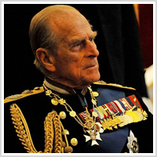

Slide 32
Prince Phillip, a great survivor
His response to his complex childhood:
‘I just lived my life’
‘it was no great deal’
Happy birthday 90 today and still going strong
And his attachment style?

Slide 33
Assessment Measures
Adults
Adult Attachment Interview AAI
Attachment Style Interview ASI
Children
Strange Situation
Stem Stories
Child Attachment Interview
Marschack Intervention Method MIM

Slide 34
Organising processes
Infant needs to regulate it’s level of arousal
Very low arousal sleep
      Restoration of bodily resources
Very high arousal screaming
      Aid to survival and protection from danger
Moderate arousal
      Allows learning and social development

Slide 35
Organisation forces
Two types of information available to child
Sequence of events (temporal order)
Learning theory and development of cognition
Intensity of stimulation
Somatic changes, related to affect & feelings

Slide 36
Attachment Categories in Childhood
Secure
B pattern Secure Secure /Autonomous 55%
Carer consistently reliable to child
Insecure
A pattern Avoidant Defended / dismissing / avoidant 23 %
    Carer consistently unreliable or available to child
C pattern Ambivalent Dependent / preoccupied 8 % Carer unreliably or inconsistently available to child
D pattern Disorganised Carer source of fear to child 15 %

Slide 37
    Attachment Categories in Adults
‘B’ pattern Secure /Autonomous 56 %
‘A’ pattern Defended / dismissing / avoidant 16 %
‘C’ pattern Dependent / preoccupied / entangled 10 %
‘D’ pattern Unresolved / disorganised 18 %

Slide 38
Attachment psychopathology
The Dynamic Maturational Model
DMM
The developmental model of Dr Patricia Crittenden

Slide 39
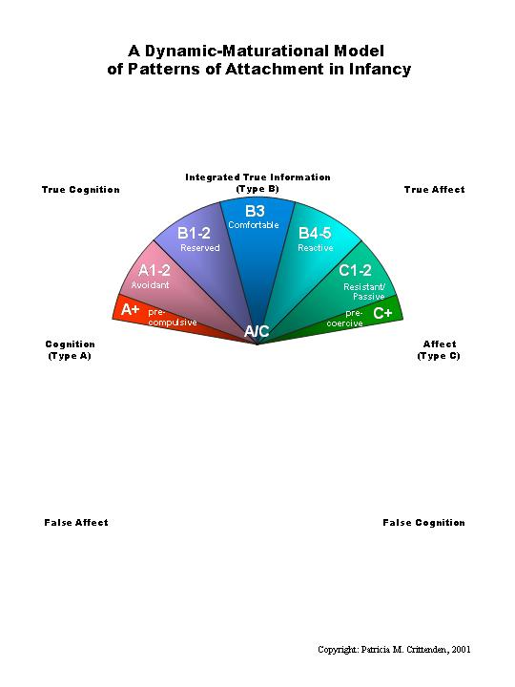

Slide 40
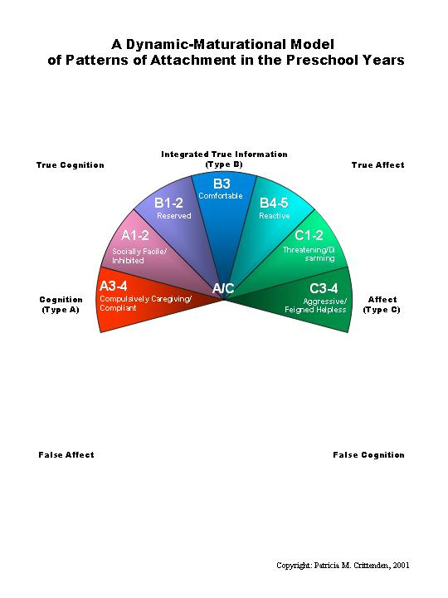

Slide 41
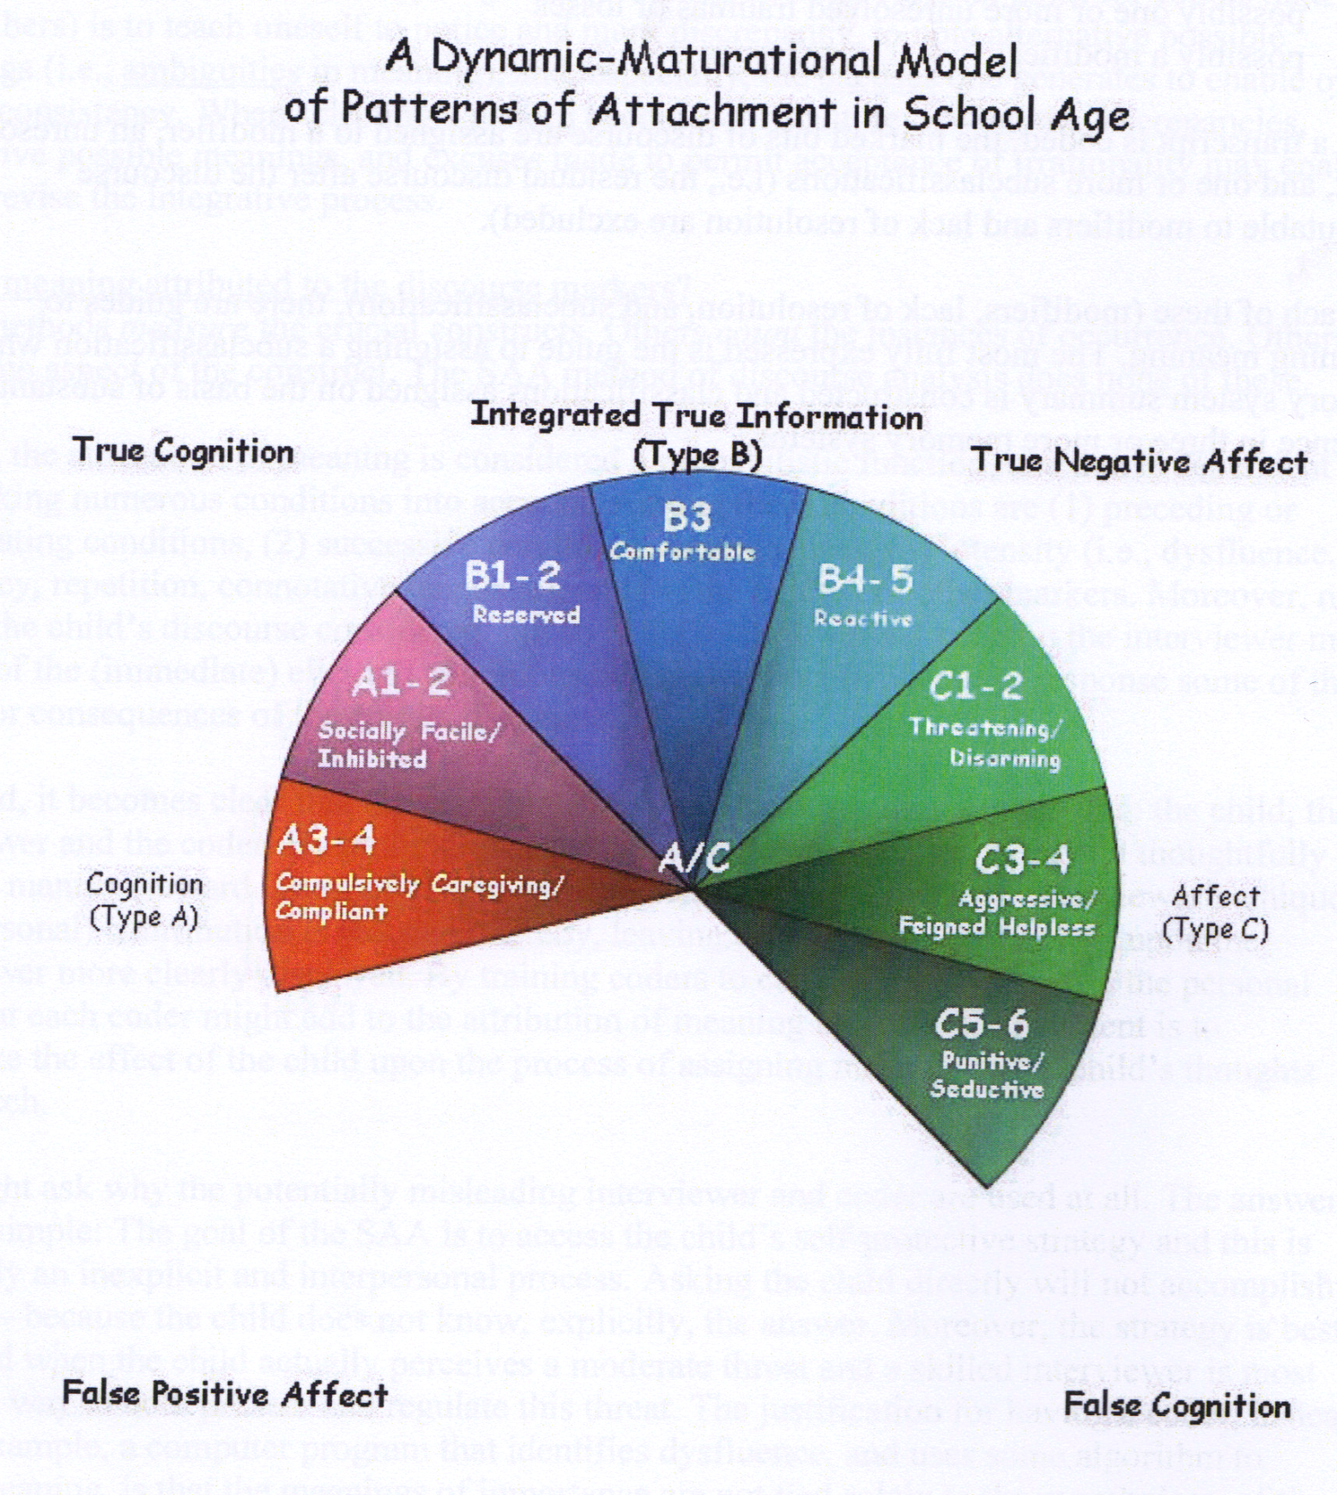

Slide 42
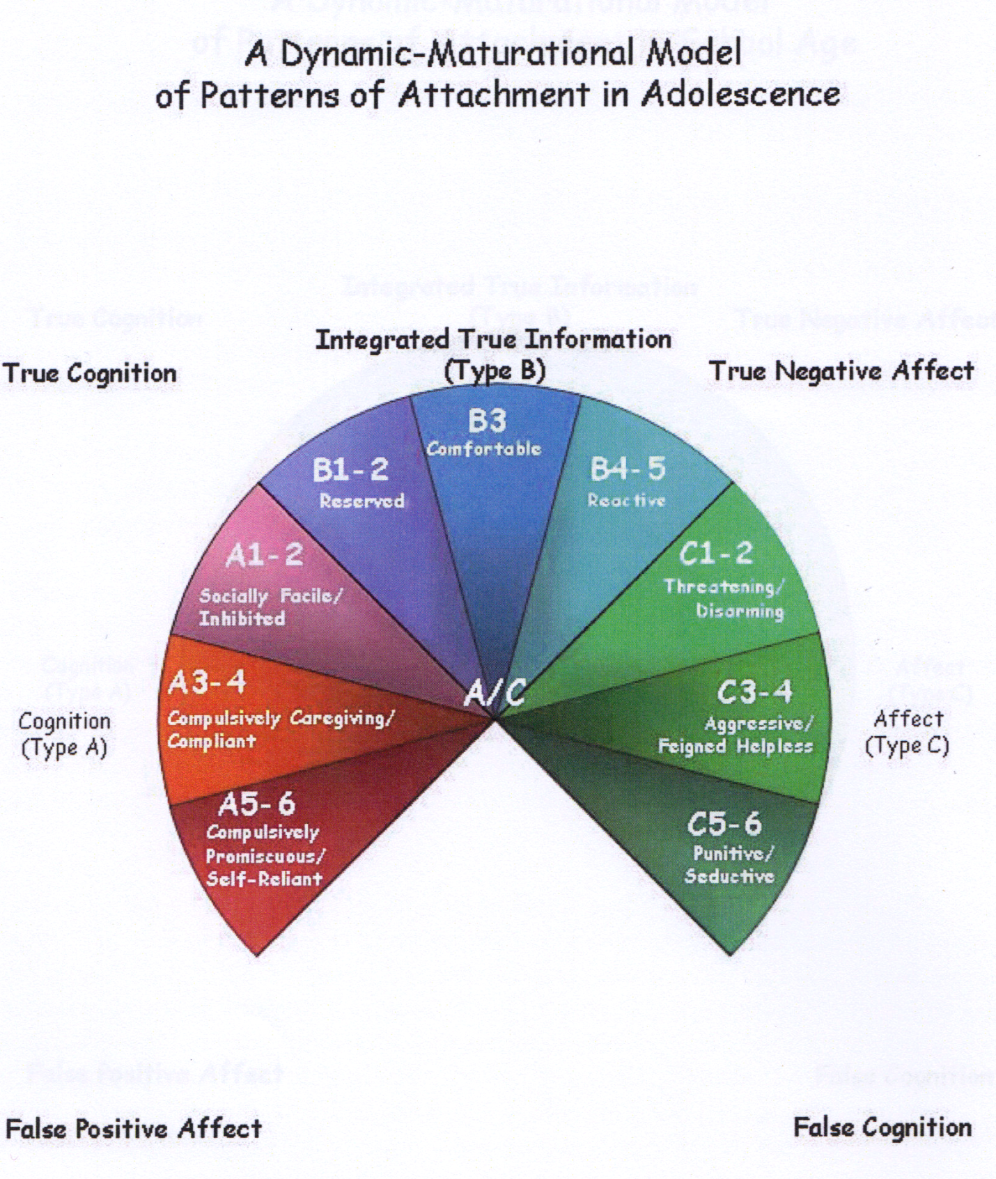

Slide 43
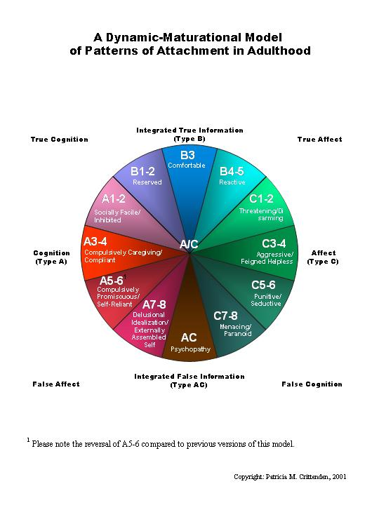

Slide 44
Therapy and Attachment
The attachment style of the parent / carer has marked impact on attachment style of the child (and thus the child’s long-term emotional and social well-being)
Therefore therapy that addresses the parent’s attachment issues (and their own history or ‘narrative’) will also benefit children in their care.
Therapy designed to increase ‘reflective functioning’ in the adult will assist the attachment aspects of parenting capacity
Individual therapy with a child will also assist an improvement in the child’s ‘reflective functioning’.
However therapy may be more effective when carried out jointly with the primary carers (birth parents or long-term alternatives)
Therapy should address attachment (with issues of security and trust) as well as developing a shared knowledge of a child’s history (or personal ‘narrative’)

Slide 45
Back to the essence of being
So, which attachment style do you think might best describe the Duke of Edinburgh?
And of course you and your nearest and dearest
Discuss

Slide 46
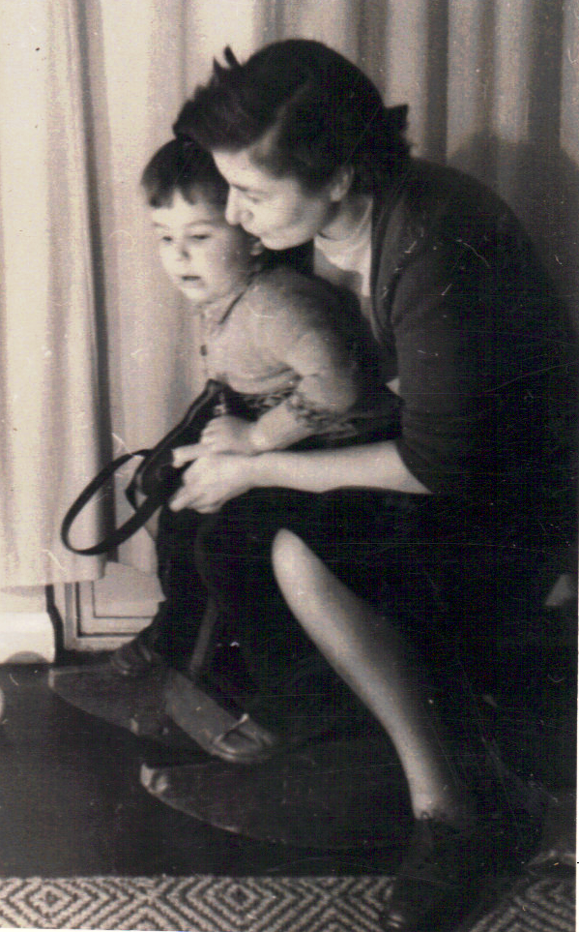

Slide 47
THE END

Slide 48
Assessment Measures
Adults
Adult Attachment Interview AAI
Attachment Style Interview ASI
Children
Strange Situation
Stem Stories
Child Attachment Interview
Marschack Intervention Method MIM

Slide 49
Adult Attachment Interview
(Mary Main and others)
Focuses on the ‘inner working model’ of the interviewee
Structured hour-long interview
Interview transcribed in full and analysed
Asks for five adjectives to describe each parent / primary carer
Asks for specific memories of events to support each adjective
Asks about response of child and parent to child being ill or upset
Asks about salient separations
Asks about experiences of rejection, threats or abuse
Asks how the above facts are seen as effecting adult personality
Analysis of transcript looks at discourse properties as well as ‘facts’
Discourse considered in terms of ‘cooperation and rationality’
Analysis (by trained scorer) gives attachment category of interviewee

Slide 50
Attachment Style Interview
ASI
Assessment of:
    Quality of marriage / partnership
    Quality of close support of others
    Ability to make and maintain supportive relationships
    Avoidant and ambivalent attitudes to attachment
    Overall attachment style and impairment to relating
    Bifulco et al 2002

Slide 51
Strange Situation
  Mother and infant together. Child has opportunity to explore and play with toys. Mother watches
  A stranger then enters the room. After a short while the stranger talks to the mother then plays with the child.
  Mother leaves the room. Stranger remains and plays with the child.
  Mother returns after a short while, say 30 seconds or as soon as infant shows heightened distress.
  Mother settles the child. The stranger leaves the room
  Mother exits the room and leaves the child on his or her own
  Stranger enters and attempts to play with and comfort the child
  The mother returns after a short while or as soon as the child begins to show heightened distress. Mother settles the child. Stranger leaves.
  Devised by Ainsworth and others

Slide 52
Narrative Story Stems
Story stems are used as a means of assessing the children’s view of their parenting figures.
Narrative story stems have been widely researched as a means of finding out what mental representations of family life children are left with when they have experienced abuse and neglect.
The techniques developed by Jill Hodges, Miriam Steele and others use thirteen short ‘stems’ or prompts. The child is asked to use some small figures and other props to show what would happen next.
What the assessor is hoping to see is the child’s concept of the internal working model of the parent/child relationship and it is central to the association between maltreatment and developmental outcome.

Slide 53
Child Attachment Interview
The Child Attachment Interview (CAI) aims to access children’s mental representations of attachment figures and significant others (if appropriate). One way of trying to access these representations is to ask children about their experiences with, and perceptions of, their parents.
The CAI is not predominantly designed to elicit biographical or episodic information, rather it attempts to capture the affective and procedural qualities of the relationships described.
Central to the CAI is the degree to which the child conceives of his or her parents as emotionally available and responsive, and is thereby able to use them as a secure base. More specifically, the CAI seeks to tap into memories (or fantasies) the child may have concerning times of crisis (e.g., personal injury, bullying), losses, and separations from parents, in addition to positive aspects of their relationships with their parents (cuddling, talking, spending time together).
(Mary Target, Peter Fonagy, Yael Shmueli-Goetz, Adrian Datta, and Tiffany Schneider 1999).

Slide 54
Therapy and Attachment
The attachment style of the parent / carer has marked impact on attachment style of the child (and thus the child’s long-term emotional and social well-being)
Therefore therapy that addresses the parent’s attachment issues (and their own history or ‘narrative’) will also benefit children in their care.
Therapy designed to increase ‘reflective functioning’ in the adult will assist the attachment aspects of parenting capacity
Individual therapy with a child will also assist an improvement in the child’s ‘reflective functioning’.
However therapy may be more effective when carried out jointly with the primary carers (birth parents or long-term alternatives)
Therapy should address attachment (with issues of security and trust) as well as developing a shared knowledge of a child’s history (or personal ‘narrative’)

Slide 55
Examples of the distancing perspective
I didn’t need comfort – everything was fine.
Childhood was perfect but don’t ask me for examples.
There was a problem in my childhood but my parents were not to blame / I was to blame.

Slide 56
distancing
I am angry / helpless because I am still waiting for them to fix it.
Here is a pseudo-problem that I want you to struggle with (not the real problem) and which can never be solved, but I need to keep people attentive to me. I will seduce or tantalise or scare you into not giving up on me.

Slide 57
Examples of the preoccupied perspective
I solved the problems because I looked after my parents or by being such a good boy/girl.
There were problems, my parents were awful but I left home and decided I could go it alone.
There were serious problems but I protected myself by anticipating every danger (because no-one else was there to protect me).

Slide 58
preoccupied
Let me tell you everything I can think of – it’s too complicated so I cannot draw conclusions about who is responsible for what.
There was a problem and my parents were to blame.

